Slide 1
M.Tech. (AIML)
Session : 6 (Probability Distribution) Team AIML

Slide 2
Session : 6 Agenda
Distributions:-
Bernoulli
Binomial
Poisson
Normal distributions.
Introduction to t-distribution
F-Distribution and
Chi Square distributions

Slide 3
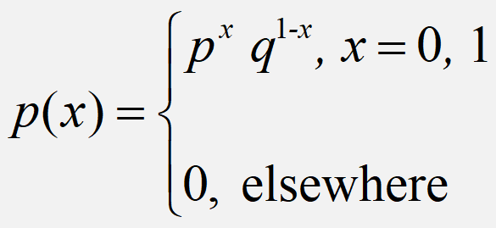
Bernoulli Distribution
A random variable ‘X’ is said to have
Bernouli distribution if its probability mass
function is given by
Definition

Slide 4
Mean & Variance

Slide 5
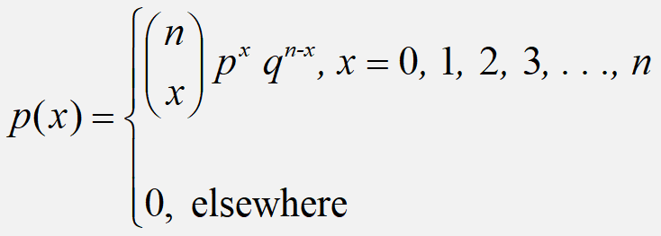
Binomial Distribution
A random variable ‘X’ is said to have
Binomial distribution if its probability mass
function is given by
Definition

Slide 6
Binomial Distribution
Binomial distribution is a discrete probability distribution.
Binomial distribution will be applied under the following experimental conditions
1) The number of trails (n) is finite
2) The trails are independent of each other
3) The probability of success p is constant for each trail.
4) Each trail results in two mutually exclusive events known as success and failure.

Slide 7
Mean & variance

Slide 8


Slide 9
Binomial Distribution
4.11 Which conditions for the binomial distribution, if any, fail to hold in the following situations?
The number of persons having a cold at a family reunion attended by 30 persons.
Ans: Getting cold is not independent. So it is not binomial
(b) Among 8 projectors in the department office, 2 do not work properly but are not marked defective. Two are selected and the number that do not work properly will be recorded
Ans: Probability of success is not same in each trial. So this is not binomial

Slide 10
Binomial Distribution Thinking Challenge
You’re a telemarketer selling service contracts for Macy’s. You’ve sold 20 in your last 100 calls (p = .20). If you call 12 people tonight, what’s the probability of
A. No sales?
B. Exactly 2 sales?
C. At most 2 sales?
D. At least 2 sales?

Slide 11
Binomial Distribution Solution*
n = 12, p = .20
A. p(0) = .0687
B. p(2) = .2835
C. p(at most 2) = p(0) + p(1) + p(2) = .0687 + .2062 + .2835 = .5584
D. p(at least 2) = p(2) + p(3)...+ p(12) = 1 – [p(0) + p(1)] = 1 – .0687 – .2062 = .7251

Slide 12
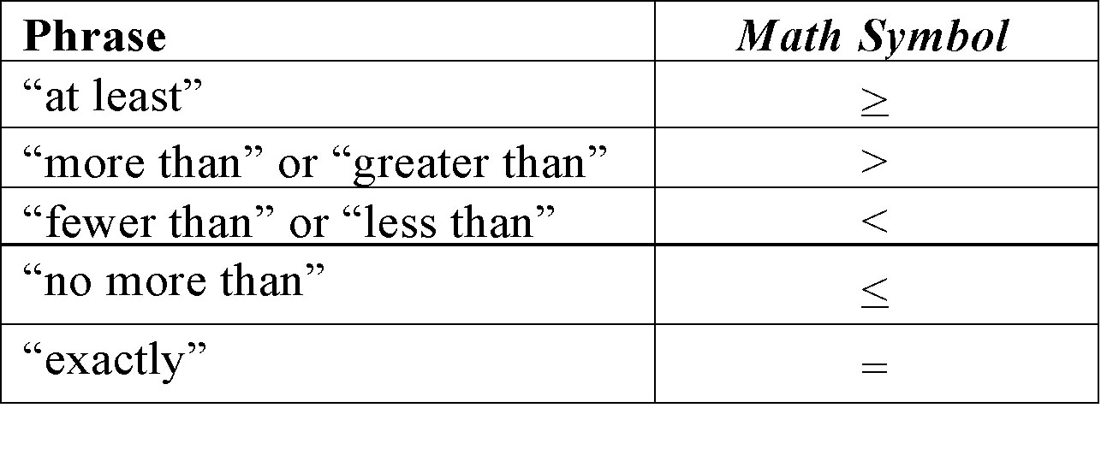
Understandings

Slide 13
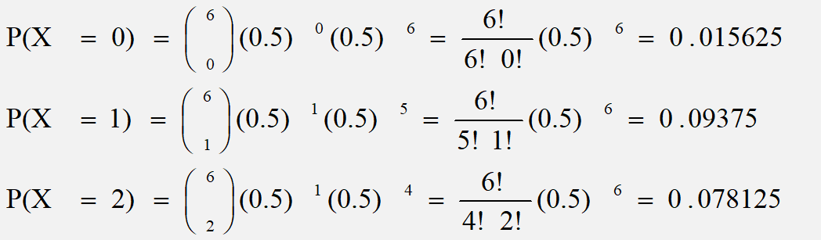
Binomial Distribution
If a coin is tossed 6 times, what is the probability of getting 2 or fewer heads?
P(x ≤ 2) = ∑p(x) = P(0)+ P(1)+ P(2)
P(x ≤ 2) = ∑p(x) = 0.015625 + 0.09375 + 0.078125 = 0.1875

Slide 14
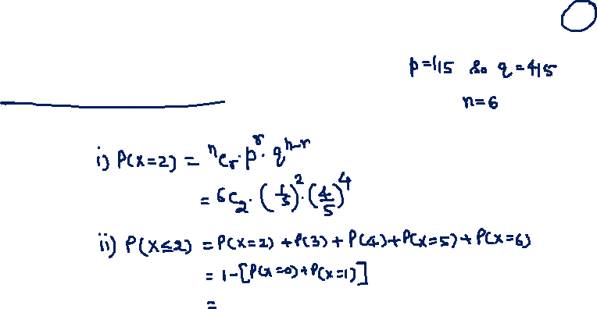
Example
The probability that a bomb dropped from a plane will strike the target is 1/5. if six such bombs are dropped.
Find the probability that
1) exactly two bombs hit the target
2) At least two will hit the target

Slide 15
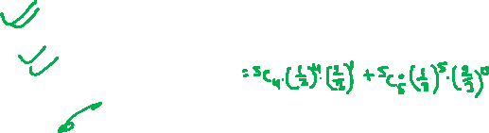
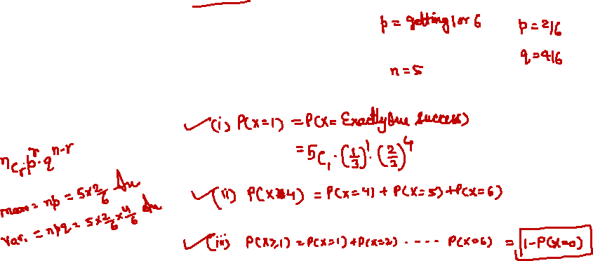

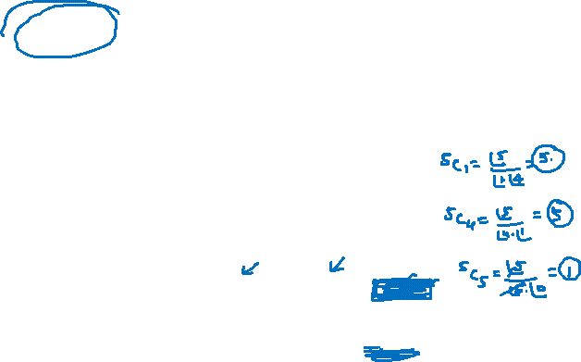
Example
An unbiased dice is thrown 5 times and occurrence of 1 or 6 considered as success find,
Probability of exactly one success
Probability of at least 4 success
Probability of at least one success
Mean and variance

Slide 16
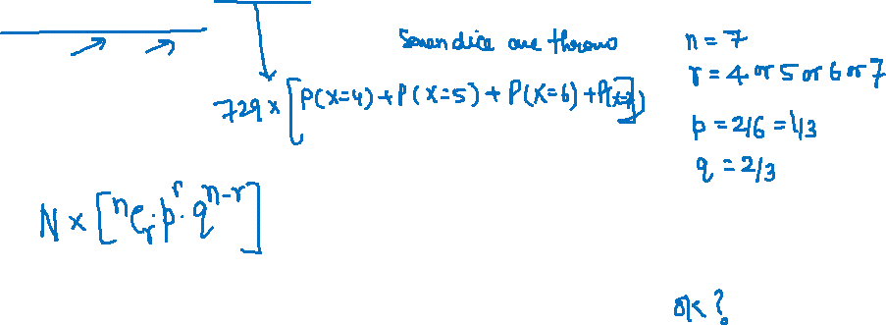
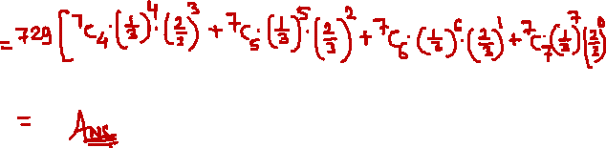
Example
Seven dice are thrown 729 times. How many times do you expect at least four dice to show three or five?

Slide 17
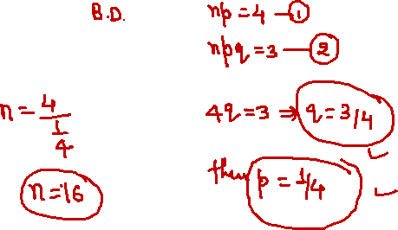
Example
Find the binomial distribution if the mean is 4 and variance is 3

Slide 18
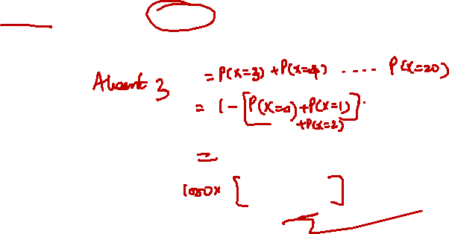
Additional problem
In a large number of parts manufactured by a machine , the mean number of defectives in a sample of 20 is 2. Out of 1000 such samples , how many would be expected to contain atleast 3 defective parts.
Sol: given n=20;
Therefore the probability that there are atleast 3 defective parts in a sample of 20 is
Hence out of 1000 samples we get 0.323*1000=323 samples

Slide 19
Discrete Probability Distribution
Discrete Probability Distributions
Binomial
Hypergeometric
Poisson

Slide 20
Binomial Distribution Recall
A binomial experiment is a probability experiment that satisfies the following conditions.
1. The experiment is repeated for a fixed number of trials, where each trial is independent of other trials.
2. There are only two possible outcomes of interest for each trial. The outcomes can be classified as a success (S) or as a failure (F).
3. The probability of a success P (S) is the same for each trial.
4. The random variable x counts the number of successful trials.

Slide 21
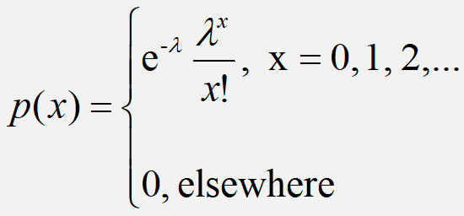
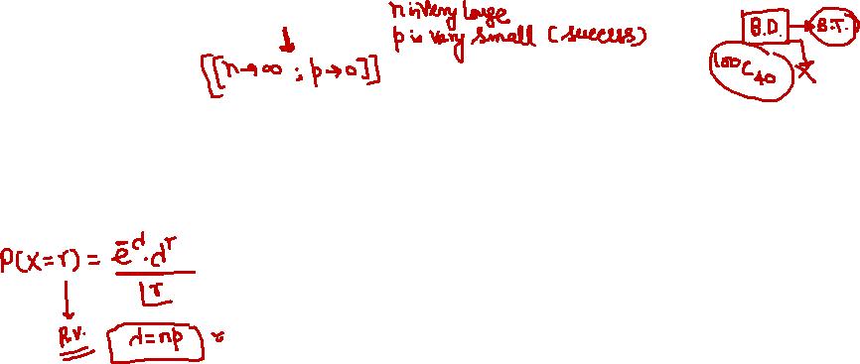
Poisson Distribution
A random variable ‘X’ is said to have
Poisson distribution if its probability mass
function is given by
Definition
Poisson distribution is the discrete probability distribution of a discrete random variable X, which may not have upper bound. It is defined for non negative values of x as follows

Slide 22
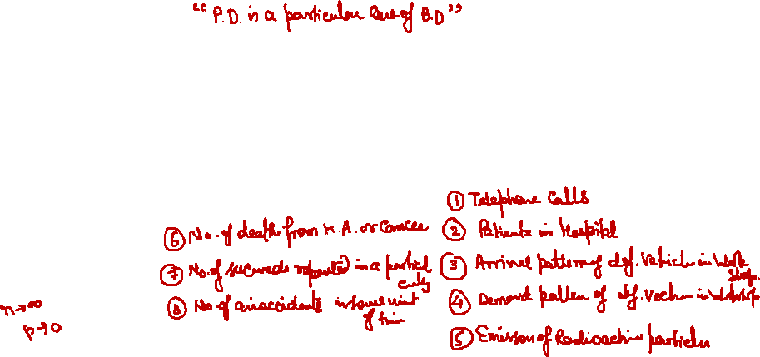
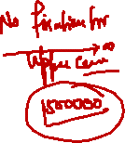
Cont…
Poisson distribution is suitable for rare events for which the probability of
occurrence ‘p’ is very small and the number of trials ‘n’ is very large.
Also binomial distribution can be approximated by Poisson distribution when
n→∞ and p →0 such that λ= np = constant

Slide 23
Example
If the probability of a bad reaction from a certain injection is 0.001.
Determine the chance that out of 2000 individuals more than two will get a bad reaction.

Slide 24
Solution

Slide 25
Poisson Distribution
Police records show that number of accident victims died in road traffic accidents is 0.1%. What is the probability that among 500 randomly selected accident victims
(i) none have died?
(ii) at least 3 have died
(iii) between 2 and 6 have died

Slide 26
Example:
Example 6: A hospital switch board receives an average of
4 emergency calls in a 10 minute interval. What is the probability that
(i) there are at most 2 emergency calls in 10 minute interval
(ii) there are exactly 3 emergency calls in a 10 minute interval
Ans: Given Mean = 4calls. We have
P(at most 2 calls) = P(x ≤ 2) = P(0)+P(1)+P(2 )=0.2381
P(Exactly 3 calls)= P(x = 3) = 0.1954

Slide 27
Example:
Example 2: The mean number of power outages in the city of Bangalore follows a Poisson variate and is 4 per year. Find the probability that in a given year,
there are exactly 3 outages, b) there are more than 3 outages.

Slide 28
Poisson Mean and Variance
Mean:
For a Poisson random variable, the variance and mean are the same!
Variance and Standard Deviation
where λ= expected number of occurrences in a given experiment.

Slide 29
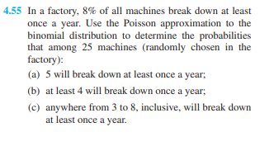
Example

Slide 30
Suggested Problems
Given that a switch board of a consultant’s office receives on the average 0.6 calls per minute, find the probabilities that
(a) in a given minute there will be at least 1 call;
(b) in a 4-minute interval there will be at least 3 calls.

Slide 31
Solution:
a) here
b)

Slide 32
Exercise:
The number of customers arriving at a cafeteria at an average rate of 0.3 per minute.
(a) Find the probability that exactly 2 customers arrive in a 10-minute span.
(b) Find the probability that 2 or more customers arrive in a 10-minute span.
(c) Find the probability that exactly one customer arrives in a 5-minute span and one customer arrives in the next 5-minute span.

Slide 33
Exercise:
The average number of trucks arriving on any one day at a truck depot in a certain city is known to be 12. what is the probability that on a given day fewer than nine trucks will arrive at this depot?

Slide 34
Exercise:
A certain kind of sheet metal has on the average, five defects per 10 square feet. If we assume a Poisson distribution, what is the probability that a 15-square-foot sheet of the metal will have at least six defects?

Slide 35
Exercise:
The number of flaws in a fiber optic cable follows a poisson process with an average of 0.6 per 100 feet.
Find the probability of exactly 2 flaws in 200 foot cable.
Find the probability of exactly 1 flaw in first 100 feet and
exactly 1 flaw in the second 100 feet.

Slide 36
Exercise:
Suppose that on an average 1 out of 10000 houses catch fire in a year in a district. If there are 2000 houses in the district, find the probability that exactly 5 house will catch fire during that year.

Slide 37
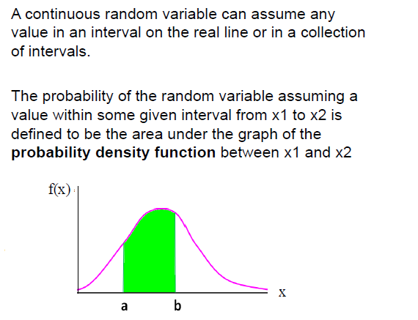
RECALL: Continuous Random Variables
Example:
Height of students in a class
Amount of ice tea in a glass
Change in temperature throughout a day
Price of a car in next year

Slide 38
Continuous Probability Distributions:
Normal Distribution:
Normal distribution is a general distribution. Any information such as heights, weights, lengths, widths, sizes, profits, prices, wages, time etc. containing sufficiently large data with mean and variance follows normal distribution. The distribution of errors of repeated measurements follows normal distribution.

Slide 39
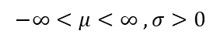
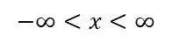
Normal Distribution
A continuous random variable X which assumes all possible values in
the entire real space, i.e., -∞<x<∞ is said to follow normal distribution with two parameters such as mean μ and variance σ² if it has the probability density function given by
$$−∞<x<∞$$
$$−∞<μ<∞ , σ>0$$

Slide 40
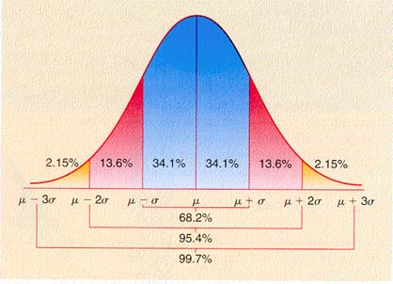
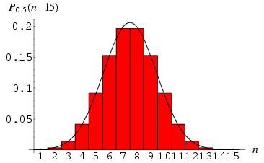
Normal Distribution
Change in Mean determines the shift in the distribution
Change in the deviation determines the spread of the data points
μ = mean
σ = standard deviation
π = 3.14159
e = 2.71828
This is a bell shaped curve with different centers and spreads depending on μ and σ
Notes:
RV is a Non-Negative Integer starting from 0.

Slide 41

Normal Distribution
f(X)
Changing μ shifts the distribution left or right.
Changing σ increases or decreases the spread.
σ
μ
X
Properties:
1. Normal curve is bell shaped and symmetric about the mean
2. Mean = Mode = Median
3. Total area under normal curve is equal to 1
4. Normal curve approaches but never touches the x axis as it extends farther and farther away from the mean

Slide 42
Normal Distribution
E(X)=μ =
Var(X)=σ² =
Standard Deviation(X)=σ
No matter what μ and σ are, the area between μ-σ and μ+σ is about 68%; the area between μ-2σ and μ+2σ is about 95%; and the area between μ-3σ and μ+3σ is about 99.7%. Almost all values fall within 3 standard deviations.

Slide 43
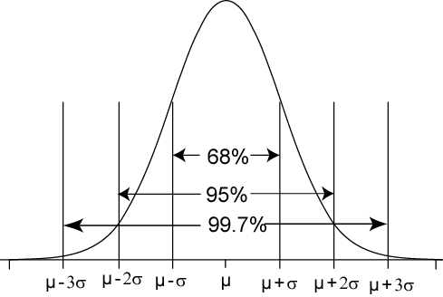
68-95-99.7 Rule for Normal Distributions
68% of the AUC(Area under curve) within ±1σ of μ
95% of the AUC within ±2σ of μ
99.7% of the AUC within ±3σ of μ

Slide 44
Standard Normal Distribution
The standard normal distribution is a normal distribution with a mean of 0 and a standard deviation of 1.
z
−3
−2
−1
0
1
2
3
All normal distributions can be converted into the standard normal curve by subtracting the mean and dividing by the standard deviation

Slide 45
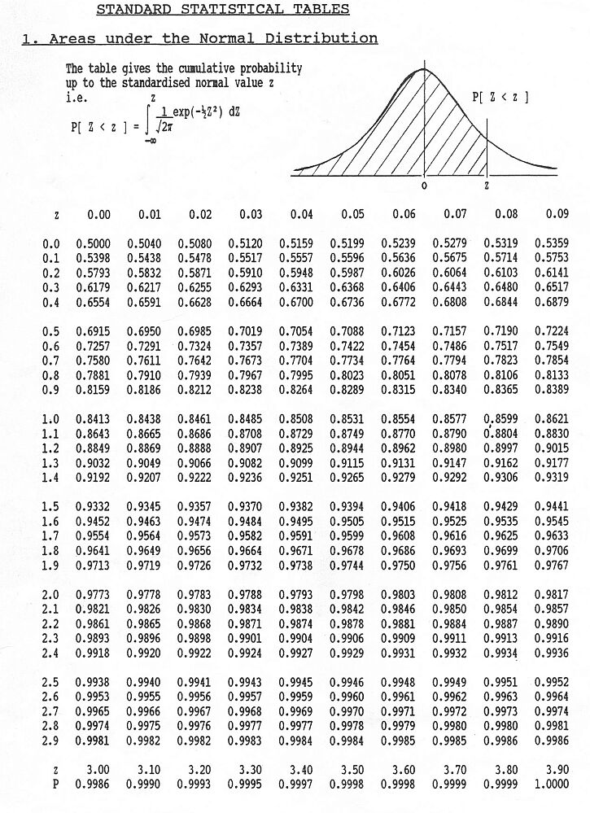

Slide 46
Problem
If a random variable has the standard normal distribution, find the probability that it will take on a value
a)less than 1.75 = P(Z < 1.75) = F(1.75) = 0.9599
b)less than -1.25 = P(Z < -1.25) = F(-1.25) = 1 –F(1.25) = 0.1056
c)greater than 2.06 = P(Z >2.06) = 1 – F(2.06) = 0.0197
d)greater than -1.82 = P(Z > -1.82) = 1- F(-1.82) =1-0.0344=0.9656
P(Z > -1.82) = 1 –F(-1.82) = 1 –(1 – F(1.82) = F(1.82) = 0.9656

Slide 47
Probability and Normal Distributions
Example:
The average on a statistics test was 78 with a standard deviation of 8. If the test scores are normally distributed, find the probability that a student receives a test score less than 90.
μ = 78
σ = 8
P(x < 90)
The probability that a student receives a test score less than 90 is 0.9332.
x
μ =78
90
z
μ =0
?
1.5
P(x < 90) = P(z < 1.5) = 0.9332

Slide 48
Probability and Normal Distributions
Example:
The average on a statistics test was 78 with a standard deviation of 8. If the test scores are normally distributed, find the probability that a student receives a test score greater than 85.
μ = 78
σ = 8
P(x > 85)
The probability that a student receives a test score greater than 85 is 0.1894.
x
μ =78
85
z
μ =0
0.88
?
P(x > 85) = P(z > 0.88) = 1 − P(z < 0.88) = 1 − 0.8106 = 0.1894

Slide 49
Probability and Normal Distributions
Example:
The average on a statistics test was 78 with a standard deviation of 8. If the test scores are normally distributed, find the probability that a student receives a test score between 60 and 80.
P(60 < x < 80)
μ = 78
σ = 8
The probability that a student receives a test score between 60 and 80 is 0.5865.
x
60
μ =78
80
z
−2.25
μ =0
0.25
?
?
P(60 < x < 80) = P(−2.25 < z < 0.25) = F(0.25) − F( −2.25)
= 0.5987 − 0.0122 = 0.5865

Slide 50
Problems
If Z ~ N(0,1), to find constants a and b such that and
a =1.37 and b =1.62
If X~N(25,36), find a constant c such that
Notes:
RV is a Non-Negative Integer starting from 0.

Slide 51
Problem
The time for oil to percolate to all parts of an engine can be treated as a random variable having a normal distribution with mean 20 seconds. Find its standard deviation if the probability is 0.25 that will take a value greater than 31.5 seconds.
Given : Mean μ = 20 seconds, P(X > 31.5) = 0.25
σ = ?

Slide 52
Ex.
Monthly Salary X in a big organisation is normally distributed
with mean Rs 3000 and standard deviation of Rs.250 what
should be the minimum salary of a worker in this organisation
so that the probability that he belongs to top 5%workers?

Slide 53
Problem
Butterfly-style valves used in heating and ventilating industries have a high flow coefficient. Flow coefficient can be modeled by a normal distribution with mean 496 C_{v} and standard deviation 25C_{v}. Find the probability that a valve will have a flow coefficient of
atleast 450C_{v}
P(X > 450) = P[( 450 – 496) /25] = P(Z > -1.84) = 1 – F(-1.84) = 1- 00329 = .9671
between 445.5 and 522C_{v}
P(445.5 <X <522) = P(-2.02 <Z <1.04) = F(1.04) – F(-2.02)= 0.8508 – 0.0217 = 0.8291

Slide 54
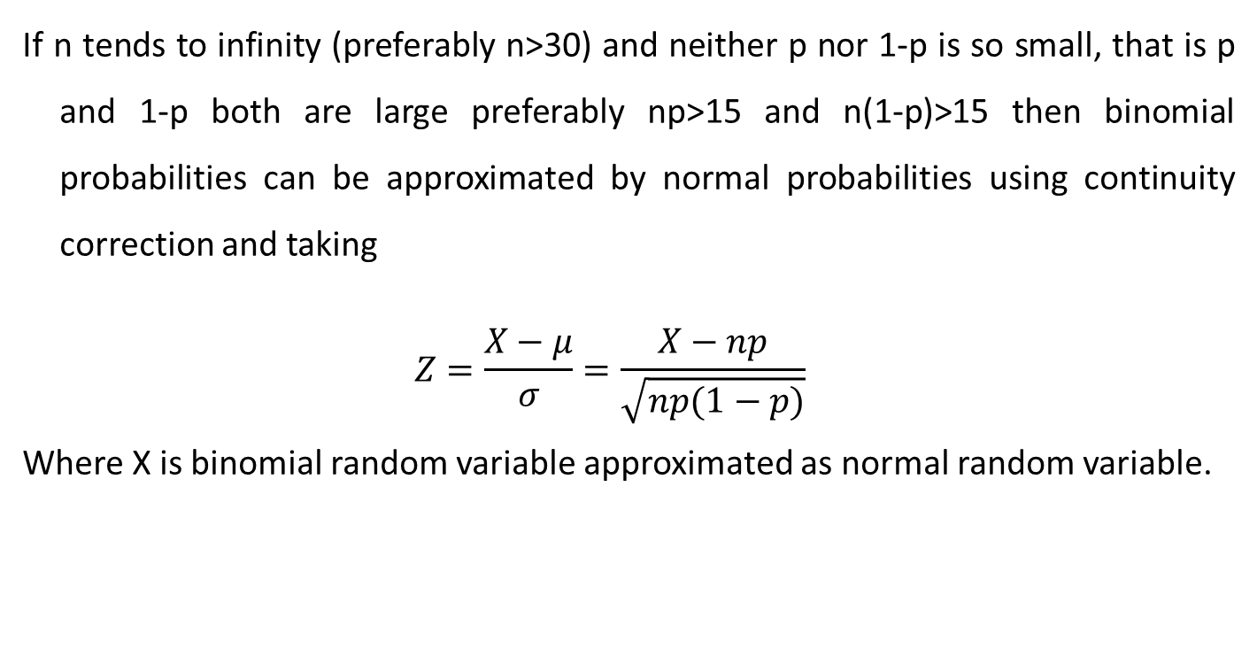
Normal Approximation to Binomial Distribution:
If n tends to infinity (preferably n>30) and neither p nor 1-p is so small, that is p and 1-p both are large preferably np>15 and n(1-p)>15 then binomial probabilities can be approximated by normal probabilities using continuity correction and taking
$$Z=\frac{X−μ}{σ}=\frac{X−np}{\sqrt{np(1−p)}}$$
Where X is binomial random variable approximated as normal random variable.

Slide 55
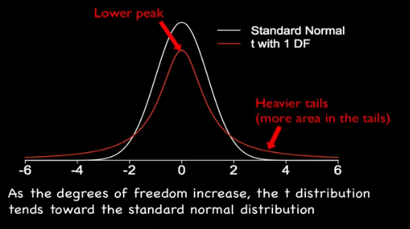
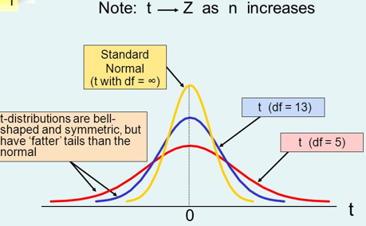
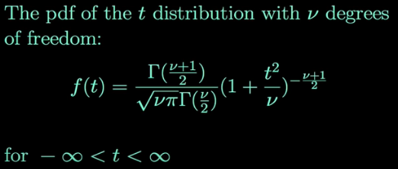
Introduction to t-distribution

Slide 56
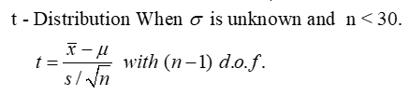

Introduction to t-distribution (Sampling distribution of mean when $σ$ unknown)
The t-distribution, also known as the Student's t-distribution, is a type of probability distribution that is similar to the normal distribution with its bell shape but has heavier tails.
It is used for estimating population parameters for small sample sizes when we don't know the standard deviation.
Where sample S.D. is calculated by formula

Slide 57
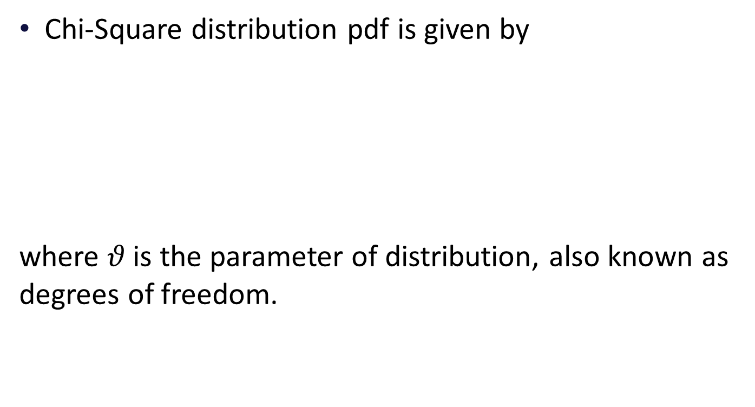
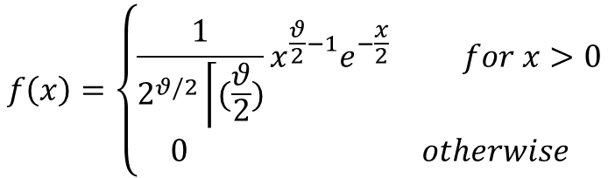
Introduction to Chi- Square( ) distribution
Chi-Square distribution pdf is given by
where $θ$ is the parameter of distribution, also known as degrees of freedom.
$$f\left(x\right)=\left\{\begin{aligned}\frac{1}{2^{θ/2}\left\lceil (\frac{θ}{2})\right.}x^{\frac{θ}{2}−1}e^{−\frac{x}{2}} for x>0 \\ 0 otherwise\end{aligned}\right.$$

Slide 58
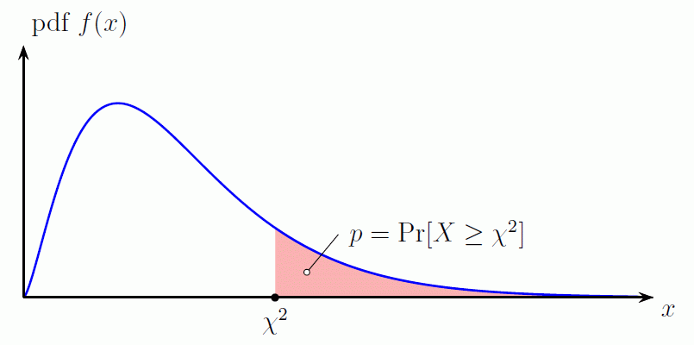
Introduction to Chi- Square( ) distribution

Slide 59
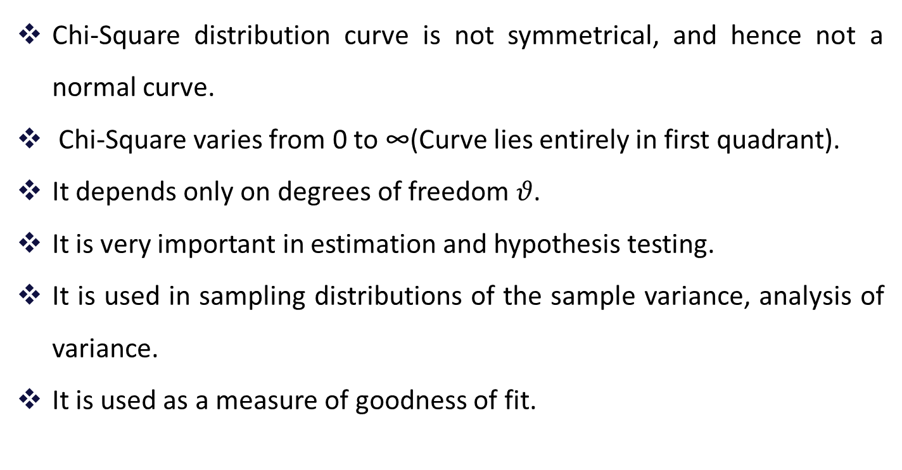
Introduction to Chi- Square( ) distribution
Chi-Square distribution curve is not symmetrical, and hence not a normal curve.
Chi-Square varies from 0 to ∞(Curve lies entirely in first quadrant).
It depends only on degrees of freedom $θ$.
It is very important in estimation and hypothesis testing.
It is used in sampling distributions of the sample variance, analysis of variance.
It is used as a measure of goodness of fit.

Slide 60
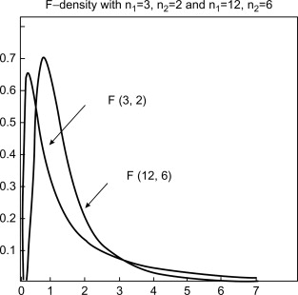
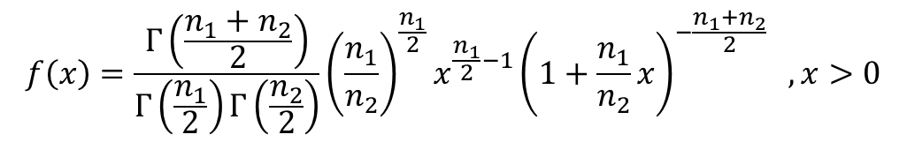
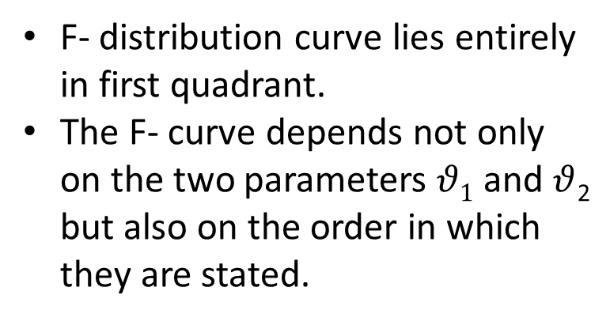
Introduction to F-distribution
(Sampling distribution of the ratio of two sample variances)
The pdf for a random variable X ~ F (n₁, n₂) is given by
$$f\left(x\right)=\frac{Γ\left(\frac{n_{1}+n_{2}}{2}\right)}{Γ\left(\frac{n_{1}}{2}\right)Γ\left(\frac{n_{2}}{2}\right)}{\left(\frac{n_{1}}{n_{2}}\right)}^{\frac{n_{1}}{2}}x^{\frac{n_{1}}{2}−1}{\left(1+\frac{n_{1}}{n_{2}}x\right)}^{−\frac{n_{1}+n_{2}}{2}} ,x>0$$
F- distribution curve lies entirely in first quadrant.
The F- curve depends not only on the two parameters $θ1$ and $θ$₂ but also on the order in which they are stated.

Slide 61
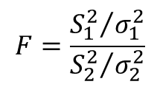
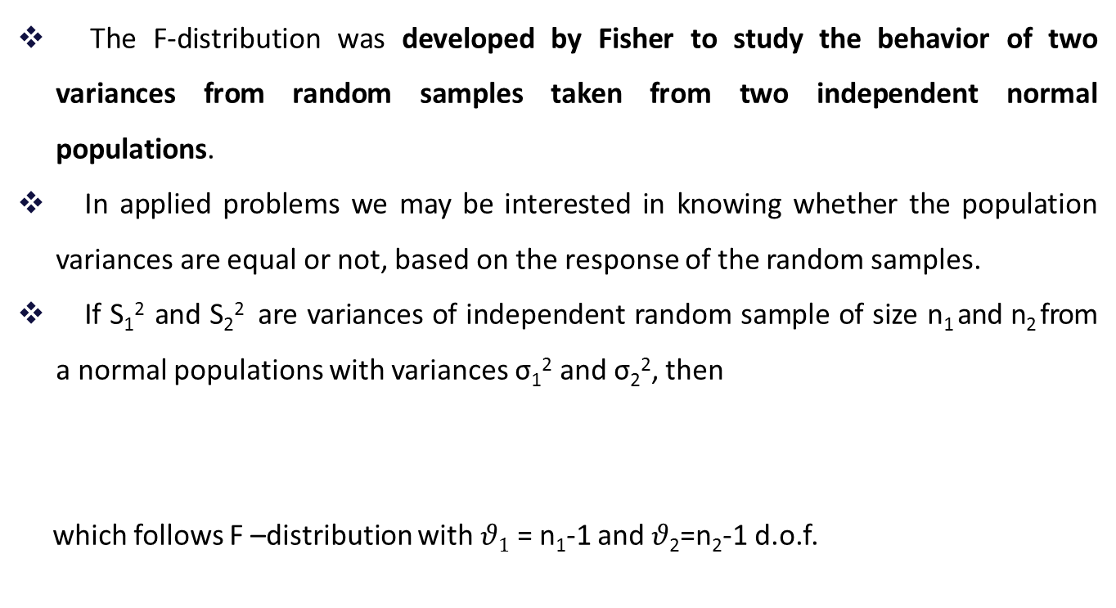
Introduction to F-distribution
(Sampling distribution of the ratio of two sample variances)
The F-distribution was developed by Fisher to study the behavior of two variances from random samples taken from two independent normal populations.
In applied problems we may be interested in knowing whether the population variances are equal or not, based on the response of the random samples.
If S₁² and S₂² are variances of independent random sample of size n₁ and n₂ from a normal populations with variances σ₁² and σ₂², then
which follows F –distribution with $θ1$ = n₁-1 and $θ$₂=n₂-1 d.o.f.
$$F=\frac{{S_{1}^{2}}/{σ_{1}^{2}}}{{S_{2}^{2}}/{σ_{2}^{2}}}$$

Slide 62
Thanks

